Slide 1
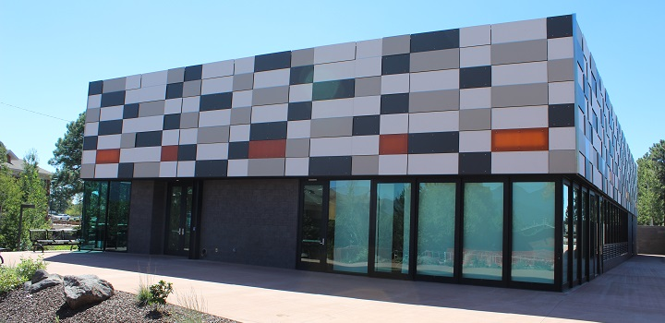

NAU International pavilion expansion
Synergy Engineering
Abdulaziz Alajmi, Phoo Myat Sandy Maung, Yijie Gao, Yang Ding

Slide 2
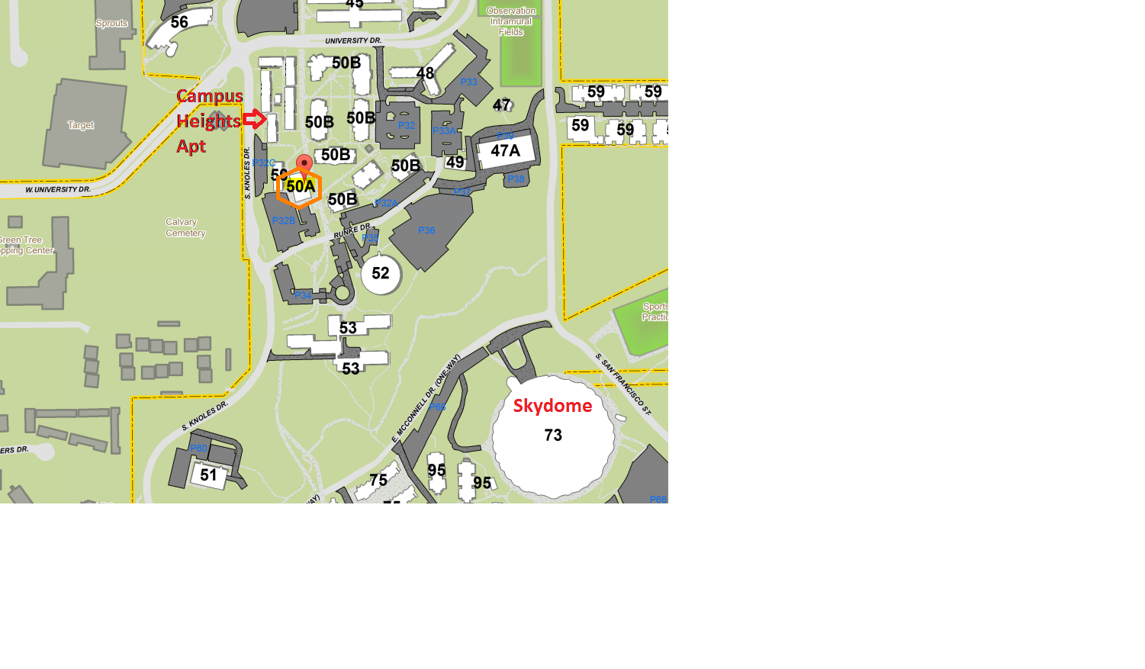
Project Background
Synergy Engineering
NAU International Pavilion: A dynamic event destination
Client: Meyer Borgman Johnson Engineering
An additional 15,000 square feet building
Adjacent to the existing one
Figure 1: NAU Campus Map
Notes:
The popularity of the existing facility has created a need for substantially more space.

Slide 3
Technical Considerations &
Potential Challenge
Synergy Engineering
Technical Considerations
Site Selection
Design Documents Review
Structural Analysis
Potential Challenge
To design an additional building aesthetically and functionally with the given site constraints

Slide 4
Stakeholders
Synergy Engineering
Meyer Borgman Johnson Engineering
Arizona Board of Regents
NAU
NAU Students
Residents near the expansion
Technical Advisors
  Dr. Robin Tuchscherer
  Professor Kaikea Kaoni

Slide 5
Scope of Services
Synergy Engineering
Task 1.0 Site Selection
Task 2.0 Surveying
Task 3.0 Design Documents Review
Task 4.0 Structural Design
Task 5.0 Construction Cost Estimate
Task 6.0 Project Management
Exclusions

Slide 6
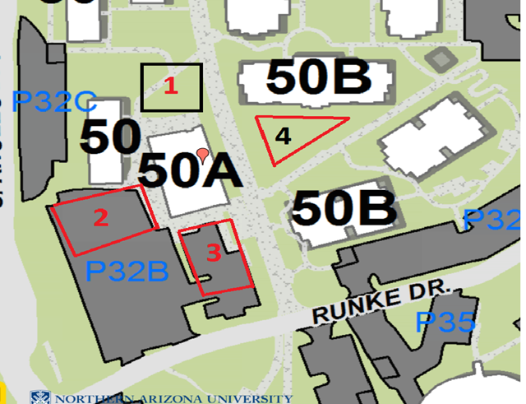
Task 1.0 Site Selection &
Task 2.0 Surveying
Synergy Engineering
Task 1.0 Site Selection
Task 2.0 Surveying
Area of footprint
Determine finished floor elevation
Quantity of fill or cut
Surrounding facilities
  Sidewalks
  Utilities
N
N

Slide 7
Task 3.0 Design Documents Review &
Task 4.0 Structural Design
Task 3.0 Design Documents Review
Task 4.0 Structural Design
Existing Geotechnical Report
NAU Technical Standards
City of Flagstaff Engineering Standards
International Building Code (IBC) 2009
Task 4.1 Building Layout Options
  Number of stories, General space layout, Connection of two buildings
Task 4.2 Foundation Plan and Details
Task 4.3 Framing Plan and Details
  Beams, Columns, Floor slabs, Basic connections, Shear walls
Task 4.4 Earth Retention Structures
  Retaining walls
Notes:
NAU Tech standards will help the design to fit the constraints of NAU.
City of Flagstaff Engr Standards will help to meet the standards.
IBC 2009 will help finalize the design to ensure it meets all design safety requirements.

Slide 8
  Task 5.0 Construction Cost Estimate & Task 6.0 Project Management
Task 5.0 Construction Cost Estimate
Task 6.0 Project Management
Site work
Foundation
Structural components
Relocation of surrounding facilities
Task 6.1 Team Management
Task 6.2 Client Management
Task 6.3 Deliverables
  50% Design Report
  Final Design Report
  Final Presentation
  Website
  Impacts

Slide 9
Exclusions
Synergy Engineering
Mechanical, Electrical and Plumbing (MEP)
Architectural Design
Utilities
Permitting
Americans with Disabilities Act (ADA)
Redesign of relocated facilities
Any items that are not listed in the scope of services

Slide 10
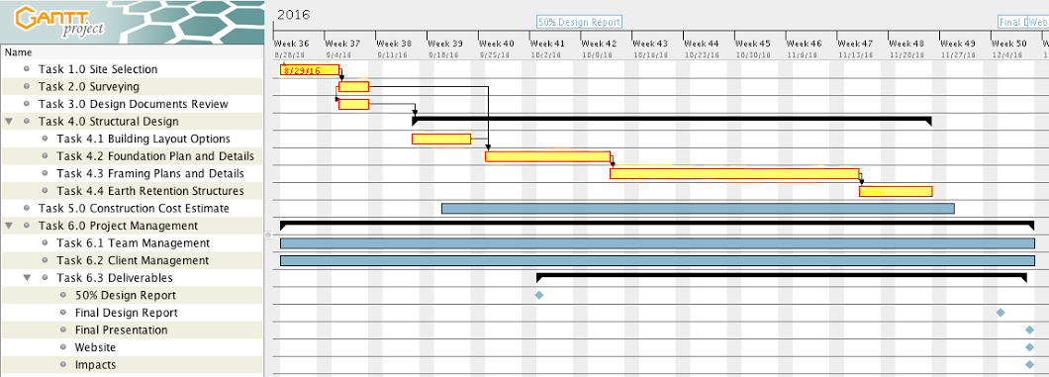
Project Schedule
Synergy Engineering

Slide 11
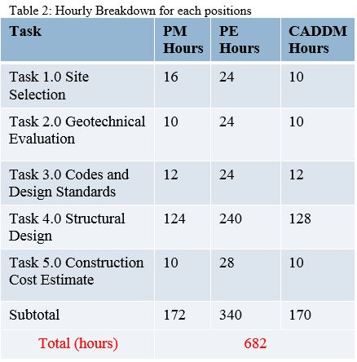
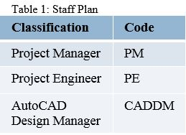
Staffing and Cost
Synergy Engineering

Slide 12
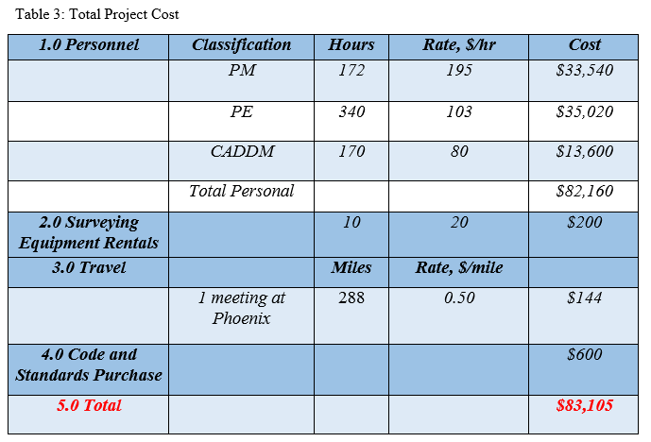
Cost of Engineering Services
Synergy Engineering

Slide 13
References
Synergy Engineering
[1] “NAU International Pavilion”, nau.edu, 2016. Available: https://nau.edu/cie/international-pavilion/
[2] Northern Arizona University, Interactive Campus Map, 2016.
[3] Peak Engineering Inc., “NAU International Student Pavilion”, Flagstaff, 2015.
[4] Speedie and Associates, “Report on Geotechnical Investigation”, Phoenix, 2014.

Slide 14

Questions?
Synergy Engineering

